Slide 1
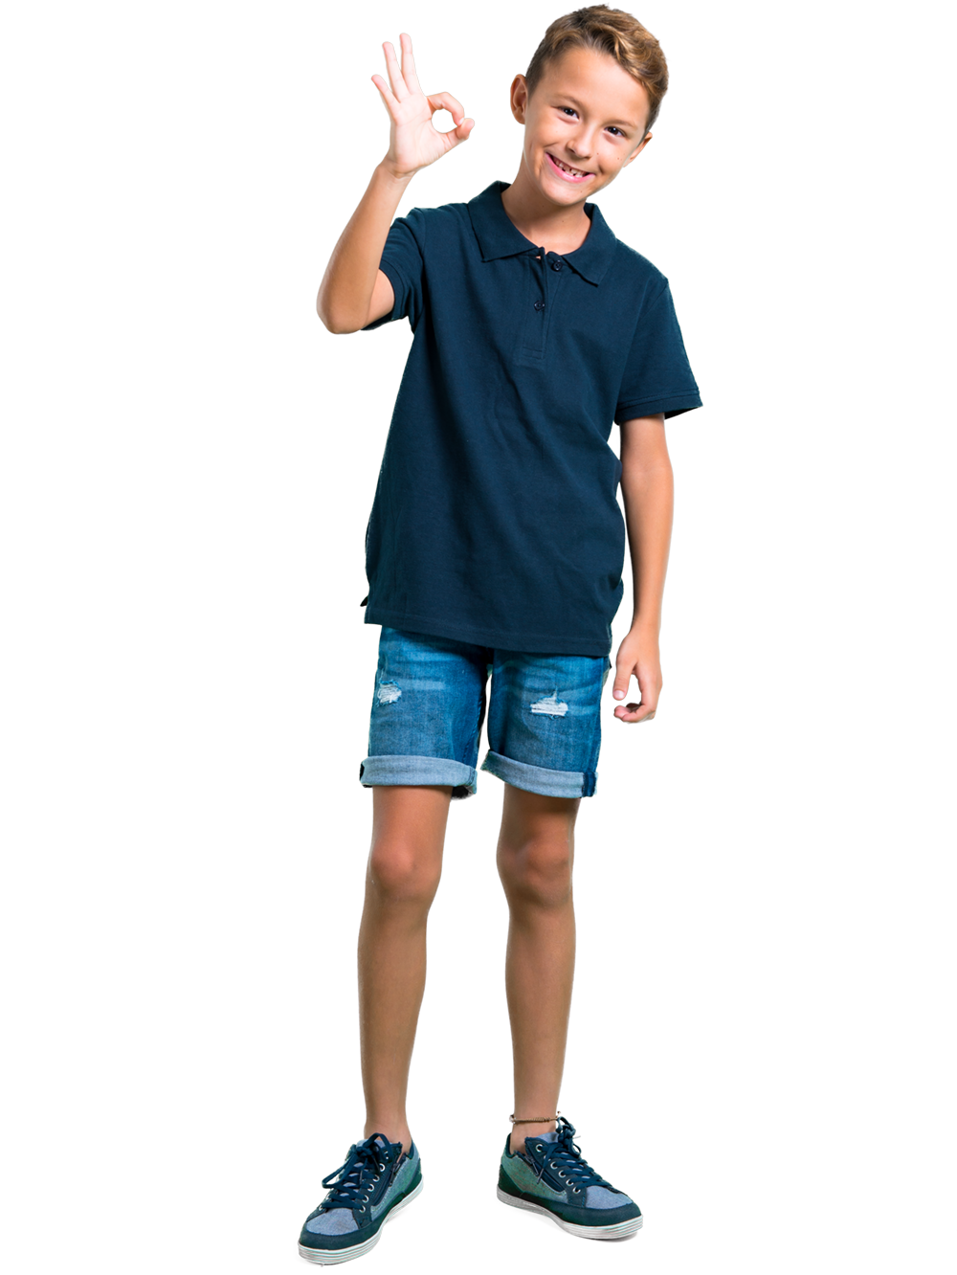
Be A Digital
Citizen
lausd.org/human-relations

Slide 2
Would You Rather
Have a pet unicorn
Have a pet dragon
lausd.org/human-relations

Slide 3
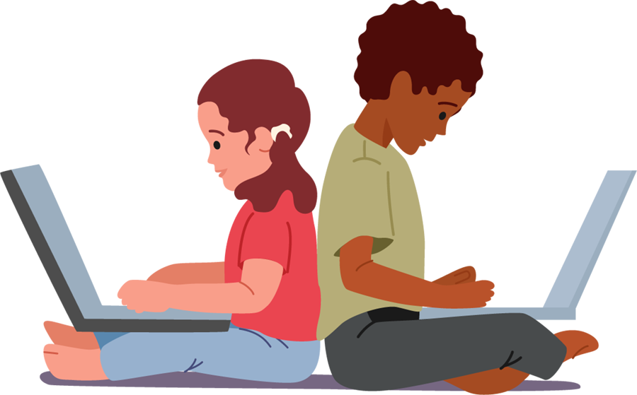
Why do we like being online?
Gaming
Social Media
Texting
Video Chatting
Watching/Sharing Videos
lausd.org/human-relations

Slide 4
The Power of Words
lausd.org/human-relations
Notes:
https://www.youtube.com/watch?v=kRHjmYO-c6w

Slide 5
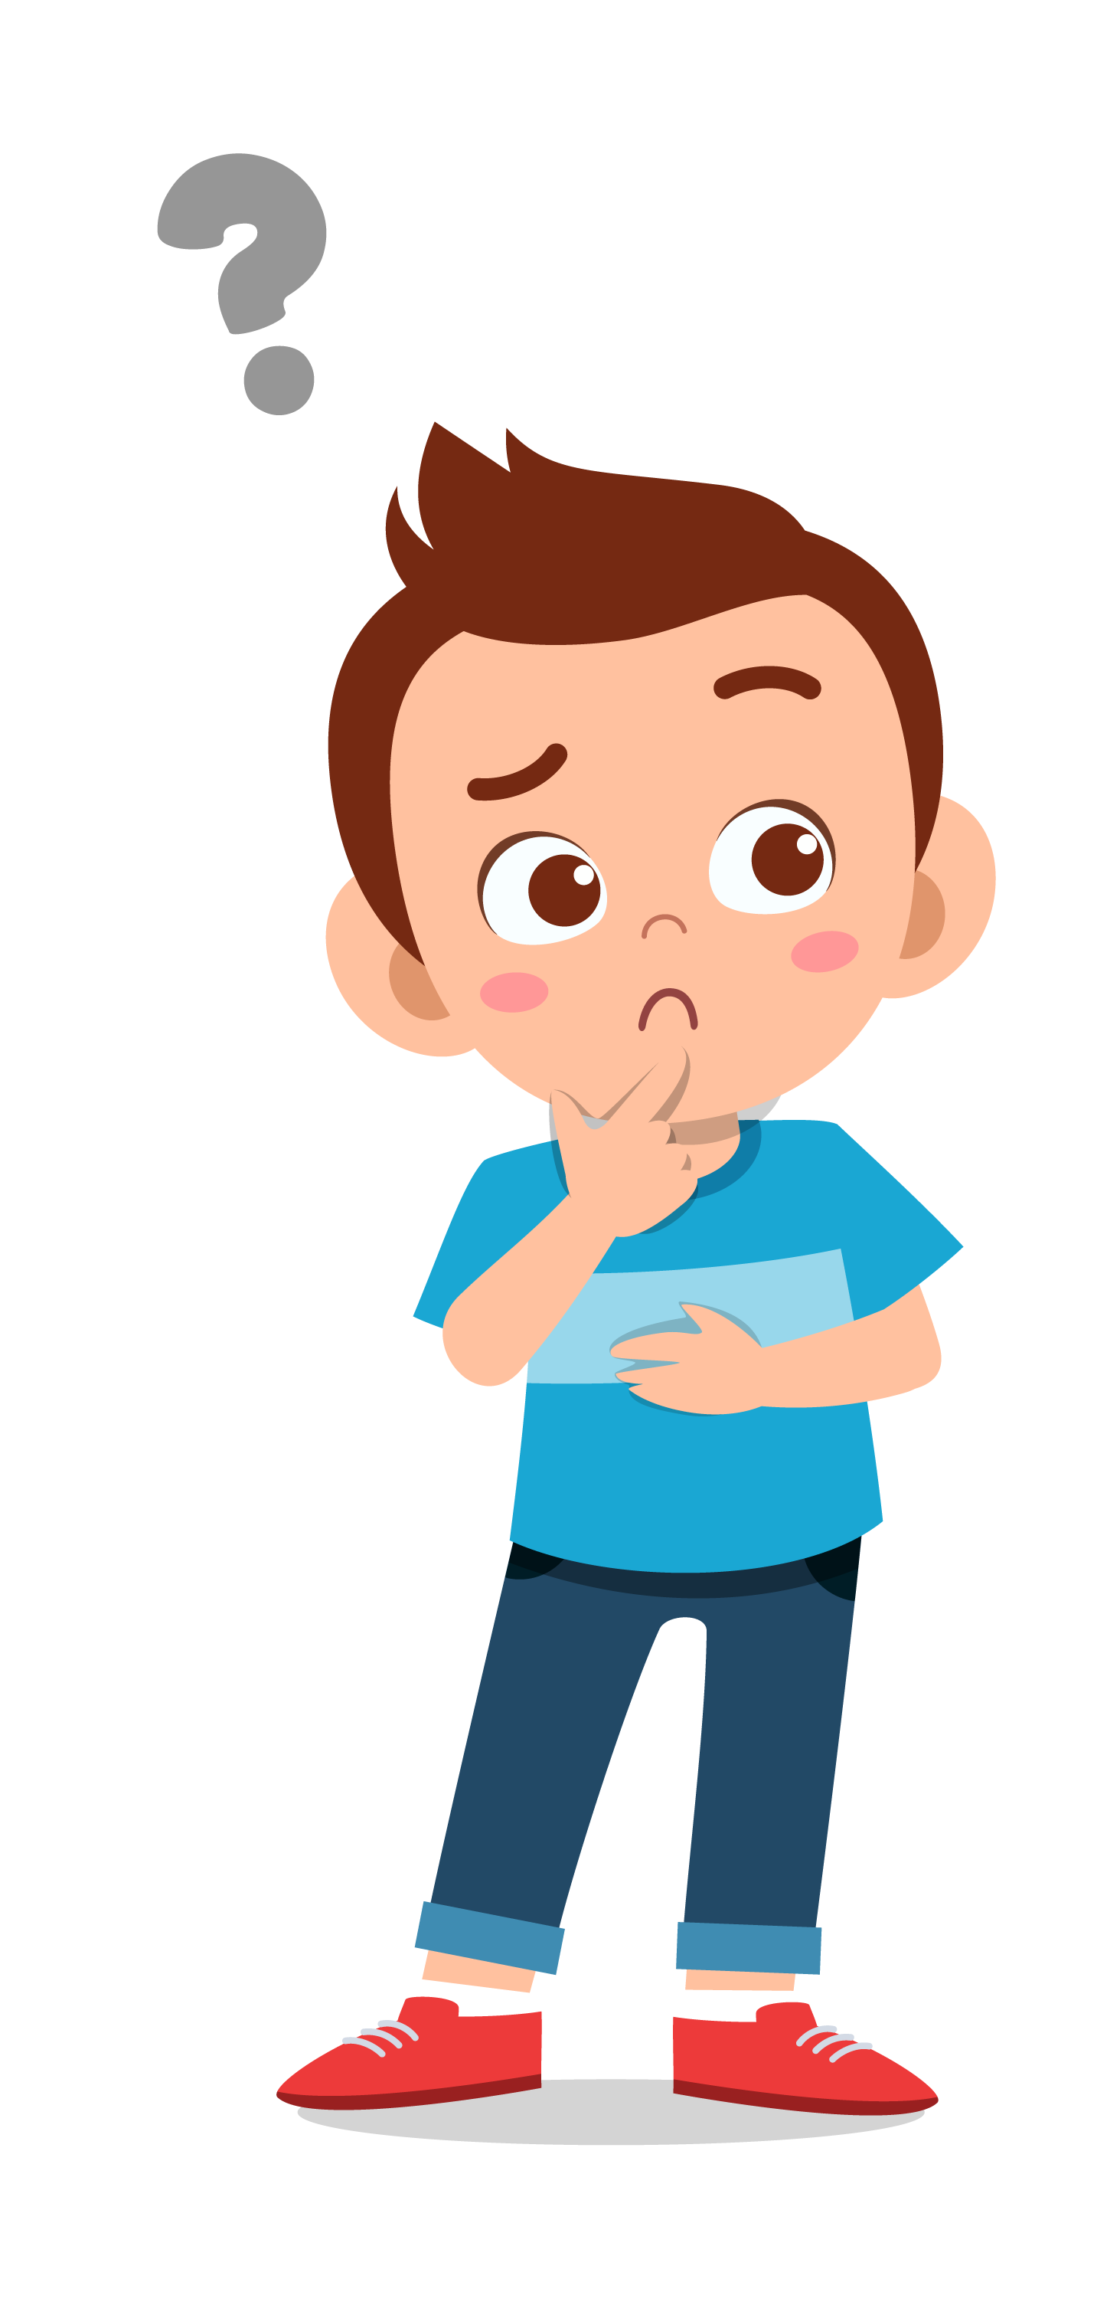
Pair Share
What happened in the video?
One minute, Guts was playing a game and having fun, and then...?
lausd.org/human-relations

Slide 6
Pair Share
What happened to Guts' friend?
The posted a picture online and then...
How could they have avoided this?
lausd.org/human-relations

Slide 7
Make A Choice to STOP
S - Step Away
T - Tell a Trusted Adult
O - OKAY Sites First
P - Pause and Think Online
lausd.org/human-relations

Slide 8
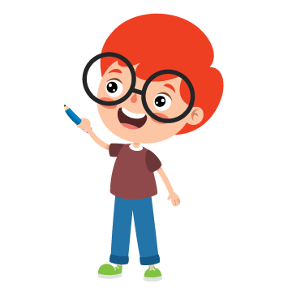
Step Away/Take a Break
If you start feeling overwhelmed or uncomfortable online, think about these things:
What can you do instead?
What other hobbies do you have?
How else can you spend your time?
Who can you hang out with in real life?
lausd.org/human-relations

Slide 9
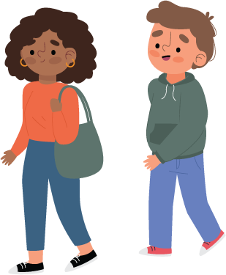
Tell A Trusted Adult
It is important to know who you can talk to when something happens that you're not sure about.
Trusted adults might include:
Parents/caregivers
Teachers
Cousins, aunts, uncles
Coaches, neighbors
lausd.org/human-relations

Slide 10
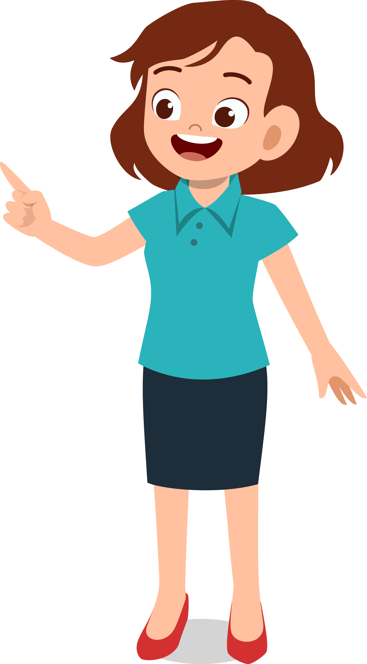
Pair Share
Who is a trusted adult YOU can talk to about things that you're not sure about?
lausd.org/human-relations

Slide 11
OKAY Sites First
Some websites, games and apps make us FEEL better than others.
We might feel SAFE when we get homework help from the online tutor
We might feel JOY when we chat with our friends
We might feel EXCITED when we win a game
lausd.org/human-relations

Slide 12
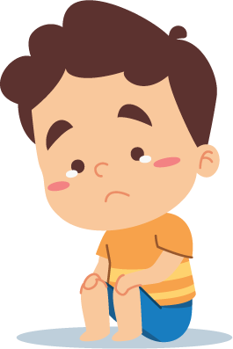
OKAY Sites First
Some websites, games and apps might feel good sometimes, and other times make us upset.
We might feel ANGRY when we can't beat the level on the game
We might feel LONELY when we see pictures of other people having fun without us
We might feel OVERWHELMED when we click on something we don't understand
lausd.org/human-relations

Slide 13
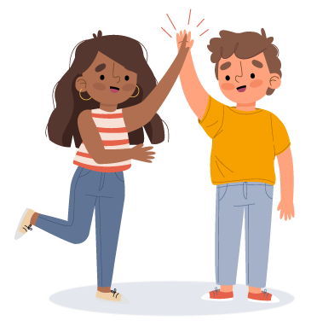
Pair Share
What apps or games do you use that make you feel good?
lausd.org/human-relations

Slide 14
Pause and THINK Online
The internet moves so fast! It can be hard to remember to slow down and THINK before we post.
Before You Post THINK
T – is it True?
H – is it Helpful?
I – is it Inspiring?
N – is it Necessary?
K – is it Kind?
lausd.org/human-relations

Slide 15
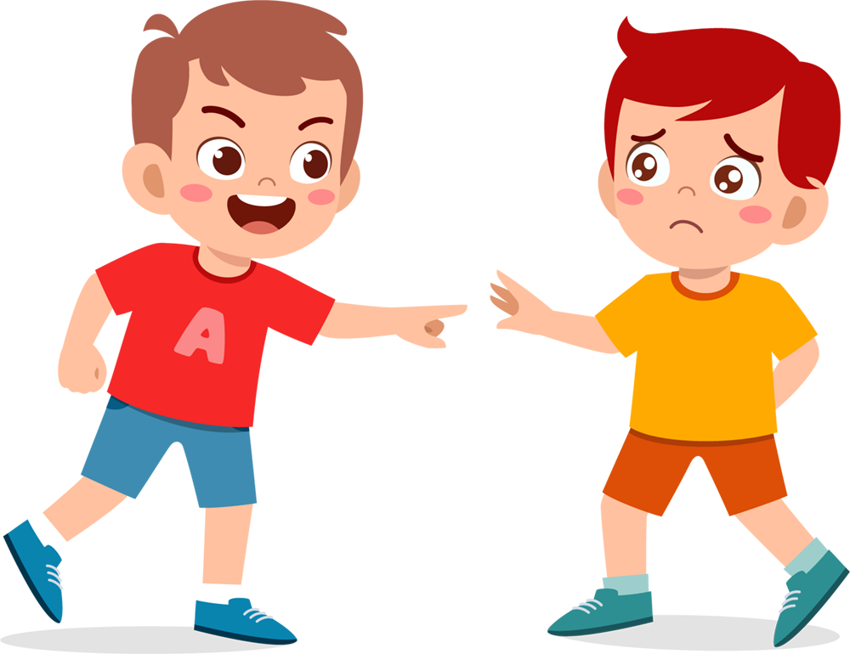
Remember
Online is still REAL life.
If you knock over someone's blocks in REAL life, you see their reactions.
lausd.org/human-relations

Slide 16
Remember
Online is still REAL life.
Just because you can't see the other persons reaction, doesn't mean it didn't happen!
lausd.org/human-relations

Slide 17
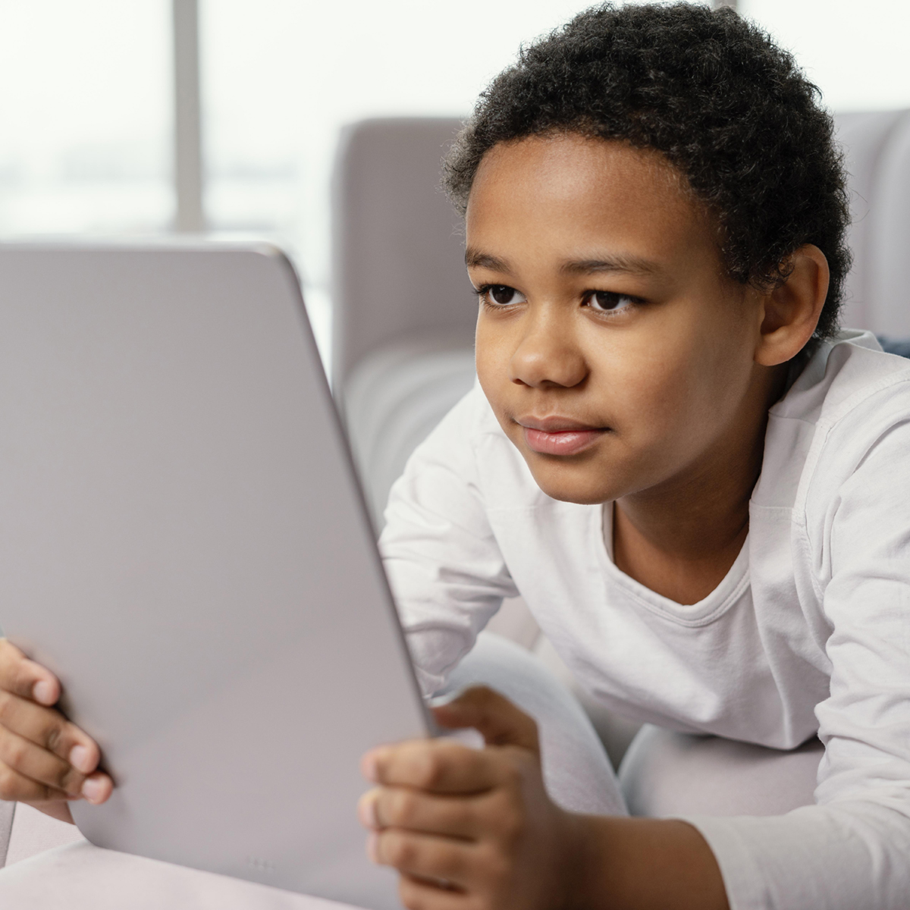
Remember
There is always someone else on the other side of the screen.
lausd.org/human-relations

Slide 18
Pop Quiz
How do you delete things from the internet?
lausd.org/human-relations

Slide 19
Pop Quiz
How do you delete things from the internet?
YOU
CAN’T
lausd.org/human-relations

Slide 20
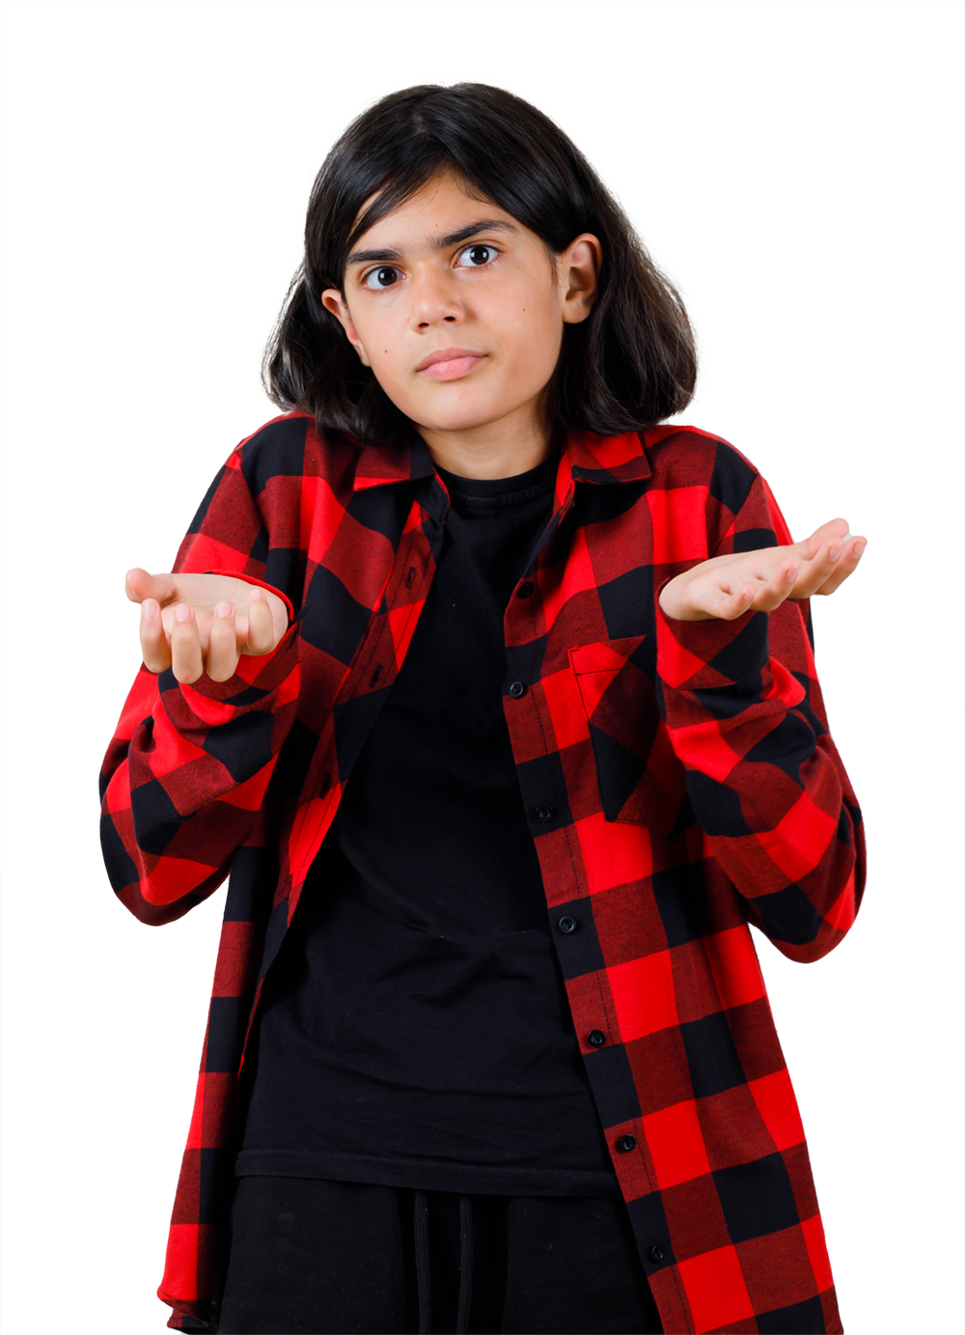
Pair Share
What choice can you make today to become a digital citizen?
lausd.org/human-relations

Slide 21
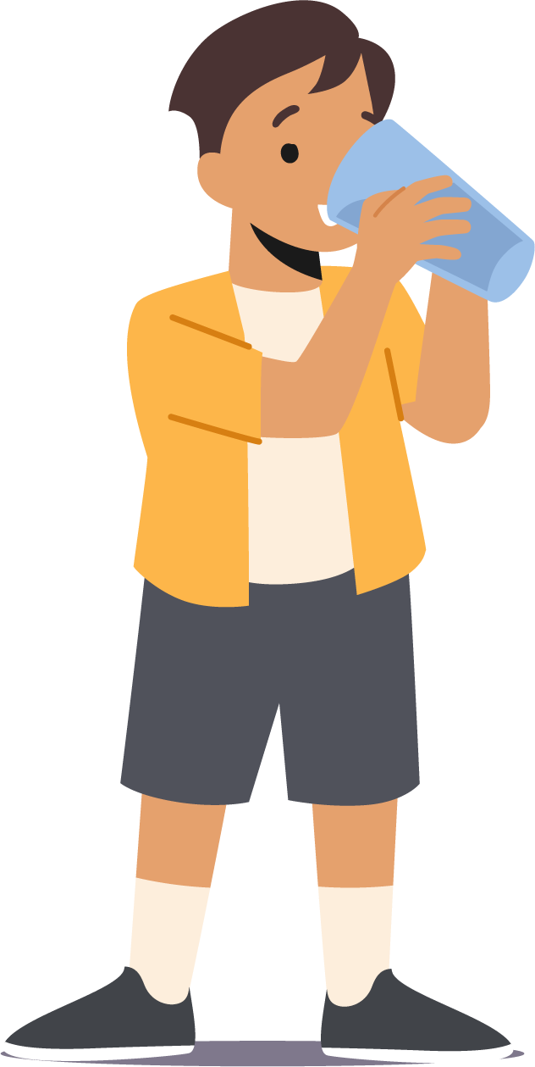
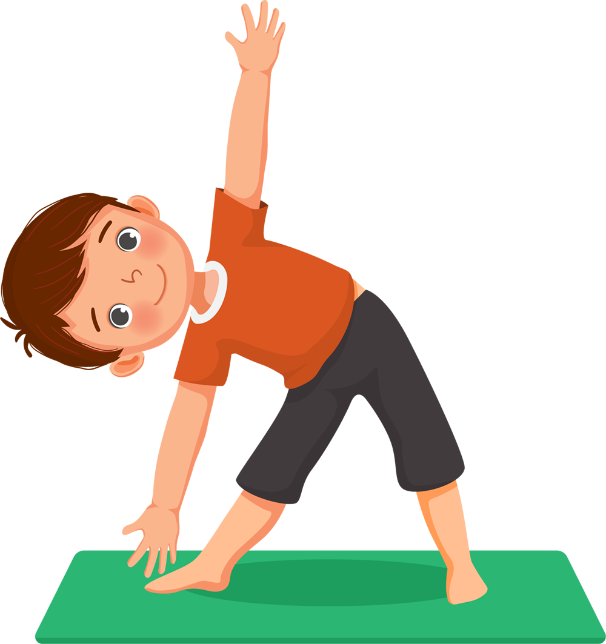
Check Out
What will you do for yourself today?
Sleep and rest well
Walk around your neighborhood
Stay hydrated
Listen to your favorite songs
Write in your journal
Workout

Slide 22
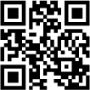
Committed to fostering a safe and respectful District, school and community culture where the seeds of peace and justice are down so that all students and staff can lead safe, purposeful and academically fruitful lives.
Connect with us at bit.ly/LAUSD-HRDE
lausd.org/human-relations

